Slide 1


FINAL PROJECT PPT
NAME:GOKADA SRAVYA
MAIL: sravyagokada@gmail.com
CYBER SECURITY

Slide 2
KEY LOGGER AND SECURITY
Understanding and Mitigating Kelogging Threats
G.SRAVYA

Slide 3


AGENDA
Introduction
Problem Statement
Project Overview
End Users
Solution and Value Proposition
Modelling
Results
Conclusion

Slide 4
PROBLEM STATEMENT
Problem:
Keyloggers are a significant threat to cybersecurity,
leading to unauthorized access to sensitive information,
identity theft, and financial
Impact:
Affects individuals, businesses, and organizations by
compromising data privacy and security

Slide 5
PROJECT OVERVIEW
Objective:
Develop a comprehensive understanding of keyloggers,
their types, how they work, and effective security measures to
prevent keylogging attacks.
Scope:
Includes an analysis of hardware and software keyloggers,
legal and ethical implications, security measures, and best practices.

Slide 6
WHO ARE THE END USERS
Individuals: Concerned about personal data security and privacy.
Businesses: Need to protect corporate data and ensure compliance with security standards.
Organizations: Require robust security measures to safeguard sensitive information.
Security Professionals: Aim to understand and mitigate keylogging threats.

Slide 7
SOLUTION AND ITS PROPOSITIONS
To avoid keyloggers
. Use anti virus program
Use password manager
Use multi factor authentication
Use a firewall
Avoid suspicious links and downloads
Change password periodically
Update your system
Use Virtual Keyboard to type passwords and sensitive information

Slide 8
MODELLING
MODELIN DESIGN:
The keylogger code is structured into modular functions for better readability
and maintenance.
Event Handling:
Utilizes the pynput library to capture and handle keyboard events.
Data Logging:
Implements functions to log captured data into text and JSON files
G.SRAVYA

Slide 9
MODELLING
Logging Functions:
Text Logging: generate_text_log(key)
Description:Writes the recorded keys to key_log.txt.
JSON Logging: generate_json_file(keys_used)
Description: Dumps the list of key events to key_log.json.
GUI Integration:
Tkinter Framework: Utilizes tkinter for creating a graphical user interface.
User Interaction:Start Button: Initiates the keylogger.
Stop Button: Stops the keylogger.
Status Updates: Provides real-time feedback on the status
of the keylogger (running/stopped).

Slide 10
RESULTS
.Successfully implemented a keylogger that captures keystrokes and records
them into both text and JSON files.
.Real-time keylogging with start and stop functionality controlled via a simple GUI.
.The keylogger project demonstrated the capability to effectively capture and log keystrokes in real-time.
.The GUI provided a user-friendly way to control the keylogger, making it accessible and easy to use.
.Emphasized the ethical use of keyloggers and the importance of implementing security measures to protect against malicious use.
G.SRAVYA

Slide 11
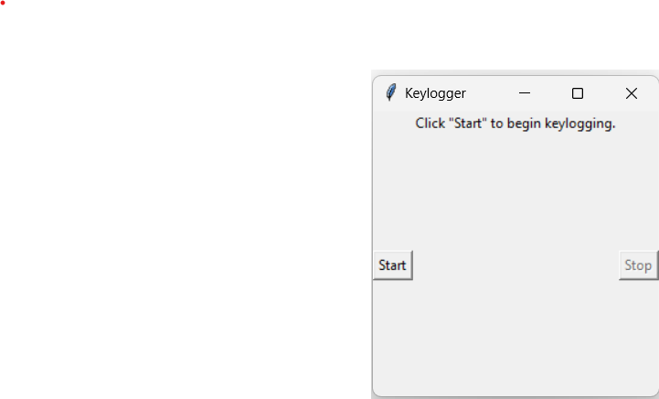
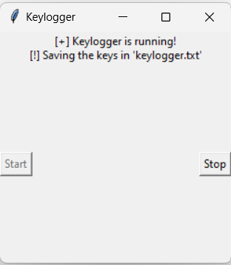
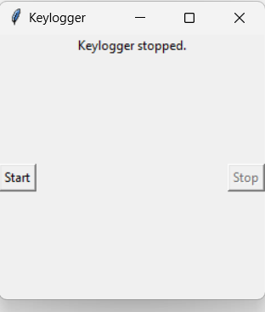
RESULTS
G.SRAVYA

Slide 12
Github Link:
https://github.com/Sravya1yadav/GOKADA-SRAVYA.git
G.SRAVYA

Slide 13
THANKU YOU
G.SRAVYA

Slide 14
G.SRAVYA

